Slide 1












Mobile data analysis
Group-18
Om Sai Vasireddy AP21110011282
Nelli UmaMaheswar Reddy AP21110011305
Vikram Muchumarri AP21110011337

Slide 2
Agenda
01.
02.
03.
04.
Introduction
Problem survey
Tools & Technologies
Methodology
05.
06.
07.
08.
Discussion
Conclusion
Future Work
References

Slide 3


1. Introduction
Project Objective This project utilizes big data tools to perform a comprehensive analysis of mobile phone market trends. The primary focus areas include:
Product Features: Analyzing specifications such as operating systems, battery capacities, storage options, and 5G support.
Pricing Structures: Examining price distributions and identifying factors influencing price points.
Brand Performance: Assessing brand presence and evaluating the overall market value of their offerings.
Significance By understanding these market aspects, stakeholders gain actionable insights into consumer preferences, enabling better strategic decisions. This analysis is beneficial for manufacturers and retailers aiming to align their products with current trends in the competitive mobile industry.
Data Processing & Visualization Tools To handle the project’s extensive data, we employed a suite of tools for efficient data extraction, storage, and visualization, ensuring that insights are both accurate and informative for decision-making.

Slide 4


2. Problem Survey
The mobile phone market has a wide range of devices to meet different consumer needs around the world.
As smartphones have become essential, people choose them based on factors like price, brand, features, and whether they support 5G.
This project analyzes a dataset of mobile phones to see what influences these choices, looking at brand popularity, operating systems (like Android vs. iOS), memory, and price trends to understand consumer preferences better.
We start by examining which brands and operating systems are popular, identifying patterns in brand loyalty and OS choice.
Then, we look at features like storage, RAM, battery life, and price, grouping phones into premium, mid-range, and budget categories. We also check out popular features like 5G and camera quality to see how advanced tech impacts decisions.
Finally, we explore where different brands originate from to see if location affects consumer behavior. These insights can help manufacturers and retailers better understand the complexities of the mobile market.

Slide 5
3. Tools & Technologies
Data Extraction
Online Data Sources: Data was collected from various online resources, to obtain comprehensive mobile phone specifications such as operating system, battery capacity, storage options, camera specifications, and 5G availability.
Data Loading
Direct Loading to Hive: The extracted data was directly loaded into the Apache Hive database, streamlining the process and enabling immediate access for analysis without intermediary steps.
Data Storage
Hadoop Distributed File System (HDFS): The data is stored in HDFS, which offers a scalable and reliable storage solution capable of managing large volumes of mobile phone data.
Data Analysis
Hive Query Language (HQL): HQL was utilized for performing complex queries within Hive, enabling in-depth exploration of the data, including analysis of operating system popularity, battery performance trends, and price fluctuations.
Data Visualization
R Programming: R was employed for creating visualizations that effectively communicate trends in the data, such as feature popularity, price comparisons among brands, and overall brand performance, providing actionable insights for stakeholders.

Slide 6
Data Description
The dataset provides a comprehensive view of the mobile device market, capturing key metrics that influence consumer preferences. It includes records for various mobile device models, detailing attributes like Phone Name, Brand, Price, and Country of Origin, which help analyze brand distribution, pricing dynamics, and regional influences.
Key Attributes
Operating System Type (e.g., Android, iOS) and Internal Storage reveal consumer preferences regarding technical specifications and brand loyalty.
RAM Storage, Battery Capacity, and USB Type offer insights into performance factors crucial for consumers seeking durability and multitasking capabilities.
5G Availability indicates the adoption of next-gen connectivity, highlighting models equipped for faster speeds.
Selfie Camera specifications address consumer demand for high-quality photography, especially for social media enthusiasts.
Segmentation The dataset categorizes devices into Price Range and Battery Capacity Range, allowing comparisons across budget-friendly to premium models. This segmentation helps identify market trends and the most attractive combinations for consumers.

Slide 7
1. Database and Table Creation in Hive
Description: A dedicated database and table were created in Hive to store and manage the mobile phone dataset effectively. This setup allows for optimized querying and storage of large datasets.
Commands Used:
Create Database: “CREATE DATABASE project_mobile”
Create Table: Within the database, a table was created with schema matching the dataset attributes.
CREATE TABLE mobile_data ( Phone_name STRING, Brands STRING, variant STRING, Price INT, Internal_Storage STRING, Operating_System_Type STRING, USB_Type STRING, FiveG_Availability STRING, Selfie_Camera STRING, RAM_Storage STRING, Country_of_Origin STRING, Battery_Capacity STRING, Price_Range STRING, Battery_Capacity_Range STRING, Total_Mobile INT)ROW FORMAT DELIMITEDFIELDS TERMINATED BY ',' -- Comma-separated formatSTORED AS TEXTFILETBLPROPERTIES ("skip.header.line.count"="1");

Slide 8

2. Data Loading into Hive Table
Description: The CSV file, already in HDFS, was loaded into the newly created Hive table.
This approach ensured a seamless transition from raw data to structured query-ready data within Hive.
Data Loading Command:
“LOAD DATA INPATH '/Big_Data/Mobile_Data.csv' INTO TABLE mobile_data;”
Description: Hive Query Language (HQL) was used to explore the dataset. Key insights were derived on attributes like operating systems, battery capacities, and brand price distributions.

Slide 9
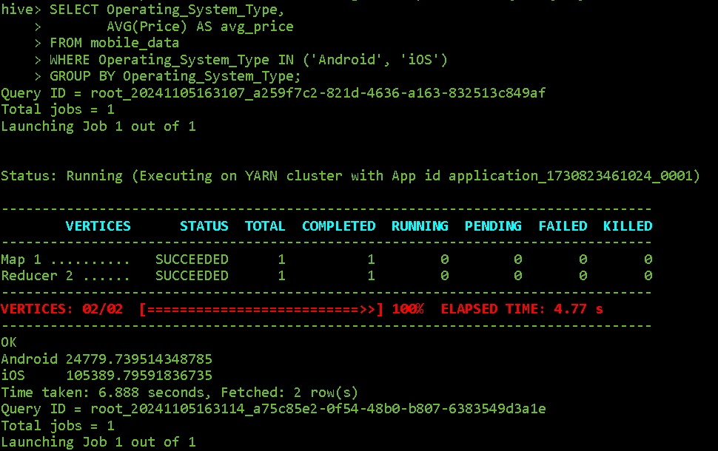
Query 1: “Average of Price for Operating Systems namely Android and IOS"
Purpose: To identify market share for each operating system.
HQL Query: "SELECT Operating_System_Type, AVG(Price) AS avg_price FROM mobile_data WHERE Operating_System_Type IN ('Android', 'iOS') GROUP BY Operating_System_Type;“
Insight: The results reveal a clear price distinction between Android and iOS phones, with iOS devices typically priced higher. This suggests that iOS targets a more premium market segment, while Android devices offer a wider price range, catering to various consumer budgets.

Slide 10
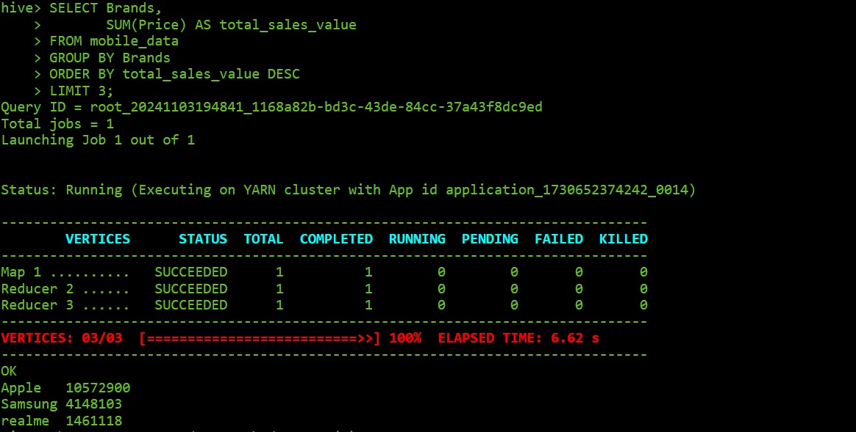
Query 2: “Top 3 brands by total sales value"
Purpose: Top 3 Brands by Total Sales Value
HQL Query: SELECT Brands, SUM(Price) AS total_sales_value FROM mobile_data GROUP BY Brands ORDER BY total_sales_value DESCLIMIT 3;
Insight: Identifying the top brands by total sales value helps understand which brands dominate the market in terms of revenue generation. High sales value for a brand often correlates with brand reputation, customer loyalty, and effective pricing strategy. Such data is valuable for competitors aiming to assess market leaders and strategize accordingly, and for brands themselves to reinforce their market position.

Slide 11
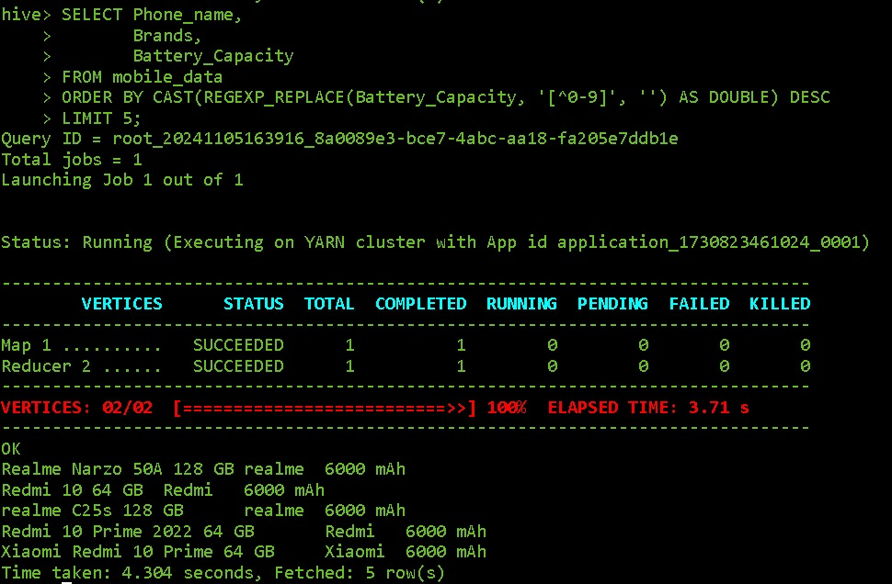
Query 3 :Top 5 phones with the largest battery capacity
Query: "SELECT Phone_name, Brands, Battery_Capacity FROM mobile_data ORDER BY CAST(REGEXP_REPLACE(Battery_Capacity, ‘[^0-9]’,’’) AS DOUBLE) DESC LIMIT 5;"
Insight: This data highlights the smartphones designed with high battery capacities lets say 6000mAh, appealing to consumers who prioritize extended usage time. Brands can leverage this information to target battery-conscious customers, while competitors can analyze which brands lead in this aspect and adjust their offerings accordingly.

Slide 12
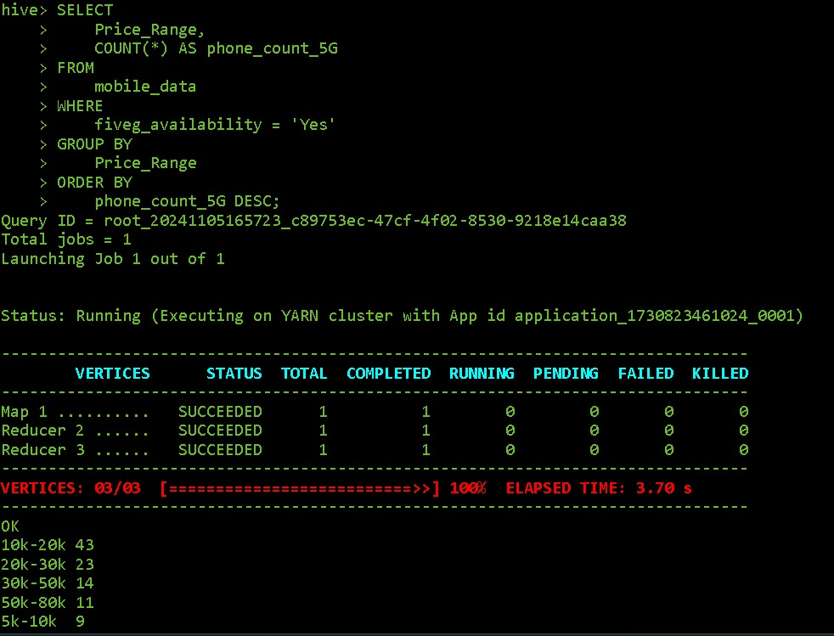
Query 4: 5G availability based on their price
Purpose: This query counts the number of 5G-enabled phones available within each price range. By grouping the data by Price_Range and counting entries where fiveg_availability is "Yes," it highlights how 5G phones are distributed across different price ranges, sorted in descending order of count.
Insight: This output reveals that the majority of 5G-enabled phones fall within the 10k-20k price range, making it the most popular range for 5G devices. This suggests that manufacturers are focusing on providing affordable 5G options to appeal to a broader market. Additionally, there is a significant presence of 5G devices in higher price ranges, indicating that both budget and premium options for 5G are available, catering to different segments of consumers.

Slide 13
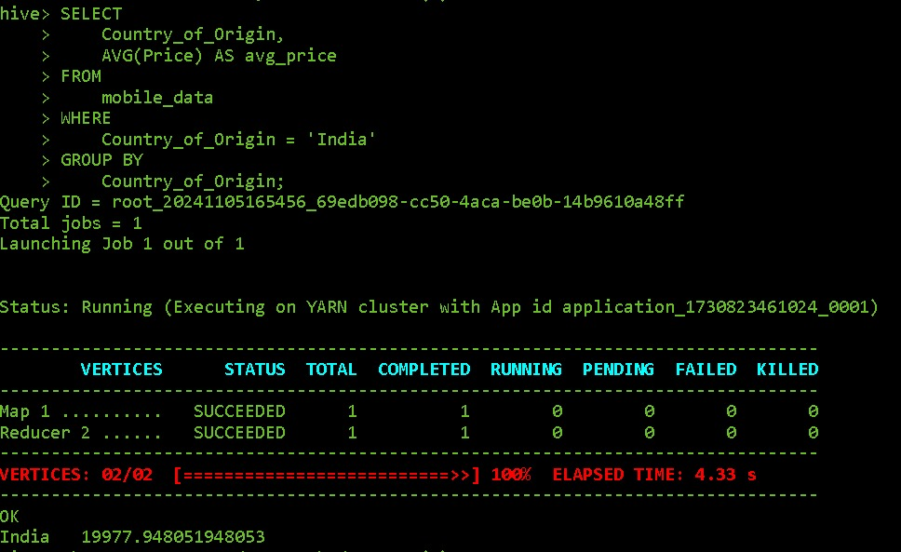
Query 5 : Average Price of the Mobiles phones in India:
Purpose of the Query: The query is designed to calculate the average price of mobile phones in India. This helps in understanding the general price point of mobile phones originating from or sold in India.
Query: “SELECT Country_of_Origin, AVG(Price) AS avg_price FROM mobile_data WHERE Country_of_Origin = 'India' GROUP BY Country_of_Origin;”
Insights: The average mobile phone price in India, around ₹20,000, suggests a strong consumer preference for mid-range devices, indicating that brands can capture a larger market by focusing on budget-friendly options. This price point serves as a strategic benchmark for brands aiming to align with local purchasing power.

Slide 14
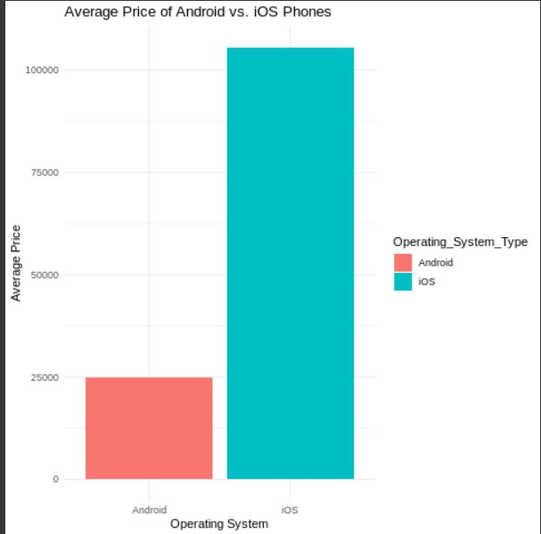
Data Visualization
Description: A horizontal bar chart illustrating the average price of Android and iOS phones.
Key Findings:
The average price of iOS phones is significantly higher than that of Android phones.Android devices show a wider range of price points, reflecting a diverse market catering to various consumer budgets.The price difference suggests that iOS targets a premium segment, while Android serves both budget-conscious and high-end consumers.This price disparity may influence consumer choice, potentially impacting market share and sales strategies for both operating systems.
Business Implications: The analysis indicates that iOS's premium pricing strategy aligns with targeting affluent consumers, while Android's diversity allows it to capture a larger share of the budget market. Companies in the mobile industry should consider these pricing dynamics when developing marketing strategies and product offerings, particularly focusing on the growing demand for affordable Android devices while maintaining a premium image for iOS products.

Slide 15
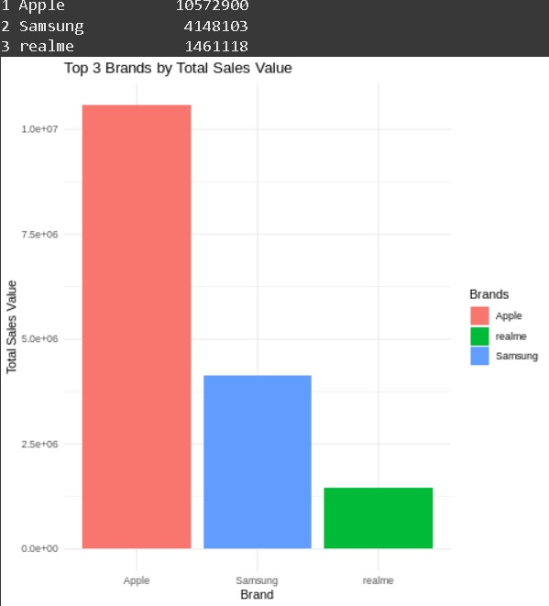
Description: A bar chart displaying the top three brands with the highest total sales value to identify leading brands in revenue.
Key Findings:
The analysis reveals the top three brands, highlighting their total sales values.These leading brands showcase substantial market presence, suggesting strong customer loyalty and effective sales strategies.The total sales values of these brands indicate their competitive advantages and potential market influence.Understanding the factors contributing to their success can provide insights for other brands aiming to enhance their sales performance.
Business Implications: The identification of top-performing brands underscores the importance of brand equity and market strategy. Other companies can analyze these leaders’ marketing techniques, product offerings, and customer engagement strategies to improve their own performance. Additionally, insights from these top brands can guide investment decisions, product development, and marketing campaigns targeting specific consumer segments.

Slide 16
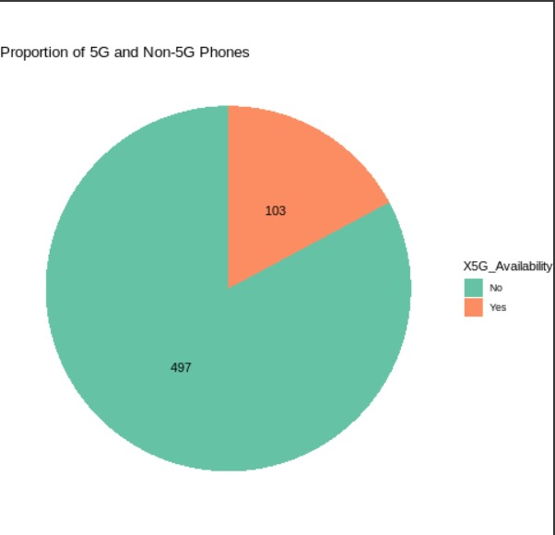
Proportion of 5G and Non-5G Phones:
Description: A pie chart displaying the proportion of 5G phones compared to Non-5G phones.
Key Findings:
The analysis reveals the distribution of phones equipped with 5G technology versus those without, indicating the current trend in mobile connectivity.
A significant proportion of the market may be shifting towards 5G phones, reflecting growing consumer demand for faster and more reliable network capabilities.
The presence of Non-5G phones in the market highlights the ongoing relevance of budget-friendly options, catering to consumers who may not prioritize the latest technology.
Business Implications: The proportion of 5G to Non-5G phones can inform manufacturers and retailers about consumer preferences and market trends. Companies should consider investing in the development of 5G devices, as demand is likely to increase. Additionally, marketing strategies may need to highlight the advantages of 5G technology to attract tech-savvy consumers, while still providing options for those who prioritize affordability over the latest features.

Slide 17
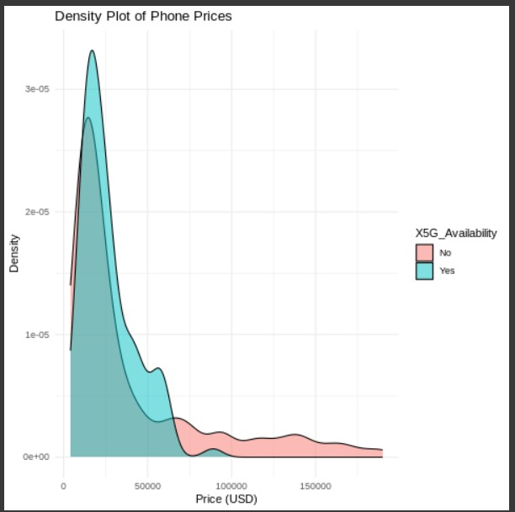
Density Plot of Phone Prices
Description: A density plot showing smartphone price distribution by 5G availability, providing insights into pricing trends in the market.
Key Findings:
Distinct Price Clusters: 5G phones generally fall into higher price ranges, while non-5G phones spread across a broader range, covering budget and mid-tier markets.
Premium for 5G: Higher price densities for 5G phones suggest added value for advanced technology.
Diverse Market for Non-5G: Non-5G phones cater to a wider consumer base, with varied pricing to meet different budgets.
Consumer Segmentation: Pricing reflects the divergence in demand between 5G and non-5G buyers.

Slide 18
Key Discussions about this analysis :
1. Brand Positioning and Market Segments: Premium brands like Apple and Samsung cater to high-end consumers, while Xiaomi and Realme target budget-conscious buyers, illustrating clear market segmentation.
2. Technology Adoption and 5G Support: Samsung and OnePlus lead in 5G adoption, focusing on future-ready features for premium consumers, whereas budget brands emphasize cost-effectiveness over 5G.
3. Battery Life and Performance Demands: Battery capacities (4000–5000 mAh) meet consumer demand for long life, while high RAM capacities appeal to users needing multitasking and gaming performance.
4. Brand Diversity and Product Line Strategy: Samsung and Xiaomi maintain diverse product lines; Samsung spans from budget to premium, while Xiaomi focuses on entry to mid-tier markets, broadening market reach.
5. Regional Impact on 5G and Innovation: South Korea and China lead in 5G-enabled devices, reflecting their advanced telecom infrastructure and dominance in 5G innovation.

Slide 19
Future Works
1. Real-Time Data Integration: Incorporate real-time data streaming with tools like Apache Kafka or Flume for up-to-date insights on mobile market trends and emerging customer preferences.
2. Machine Learning Models: Apply machine learning, such as regression or clustering, to predict demand, price shifts, and brand popularity, and identify features that drive higher sales.
3.Scalability for Larger Data Sets : Enhance scalability using big data technologies like Apache Spark or Hadoop YARN to handle growing volumes and complexity in mobile data.

Slide 20




Thank you

